Slide 1
Water Safety Progression Step 2

Slide 2


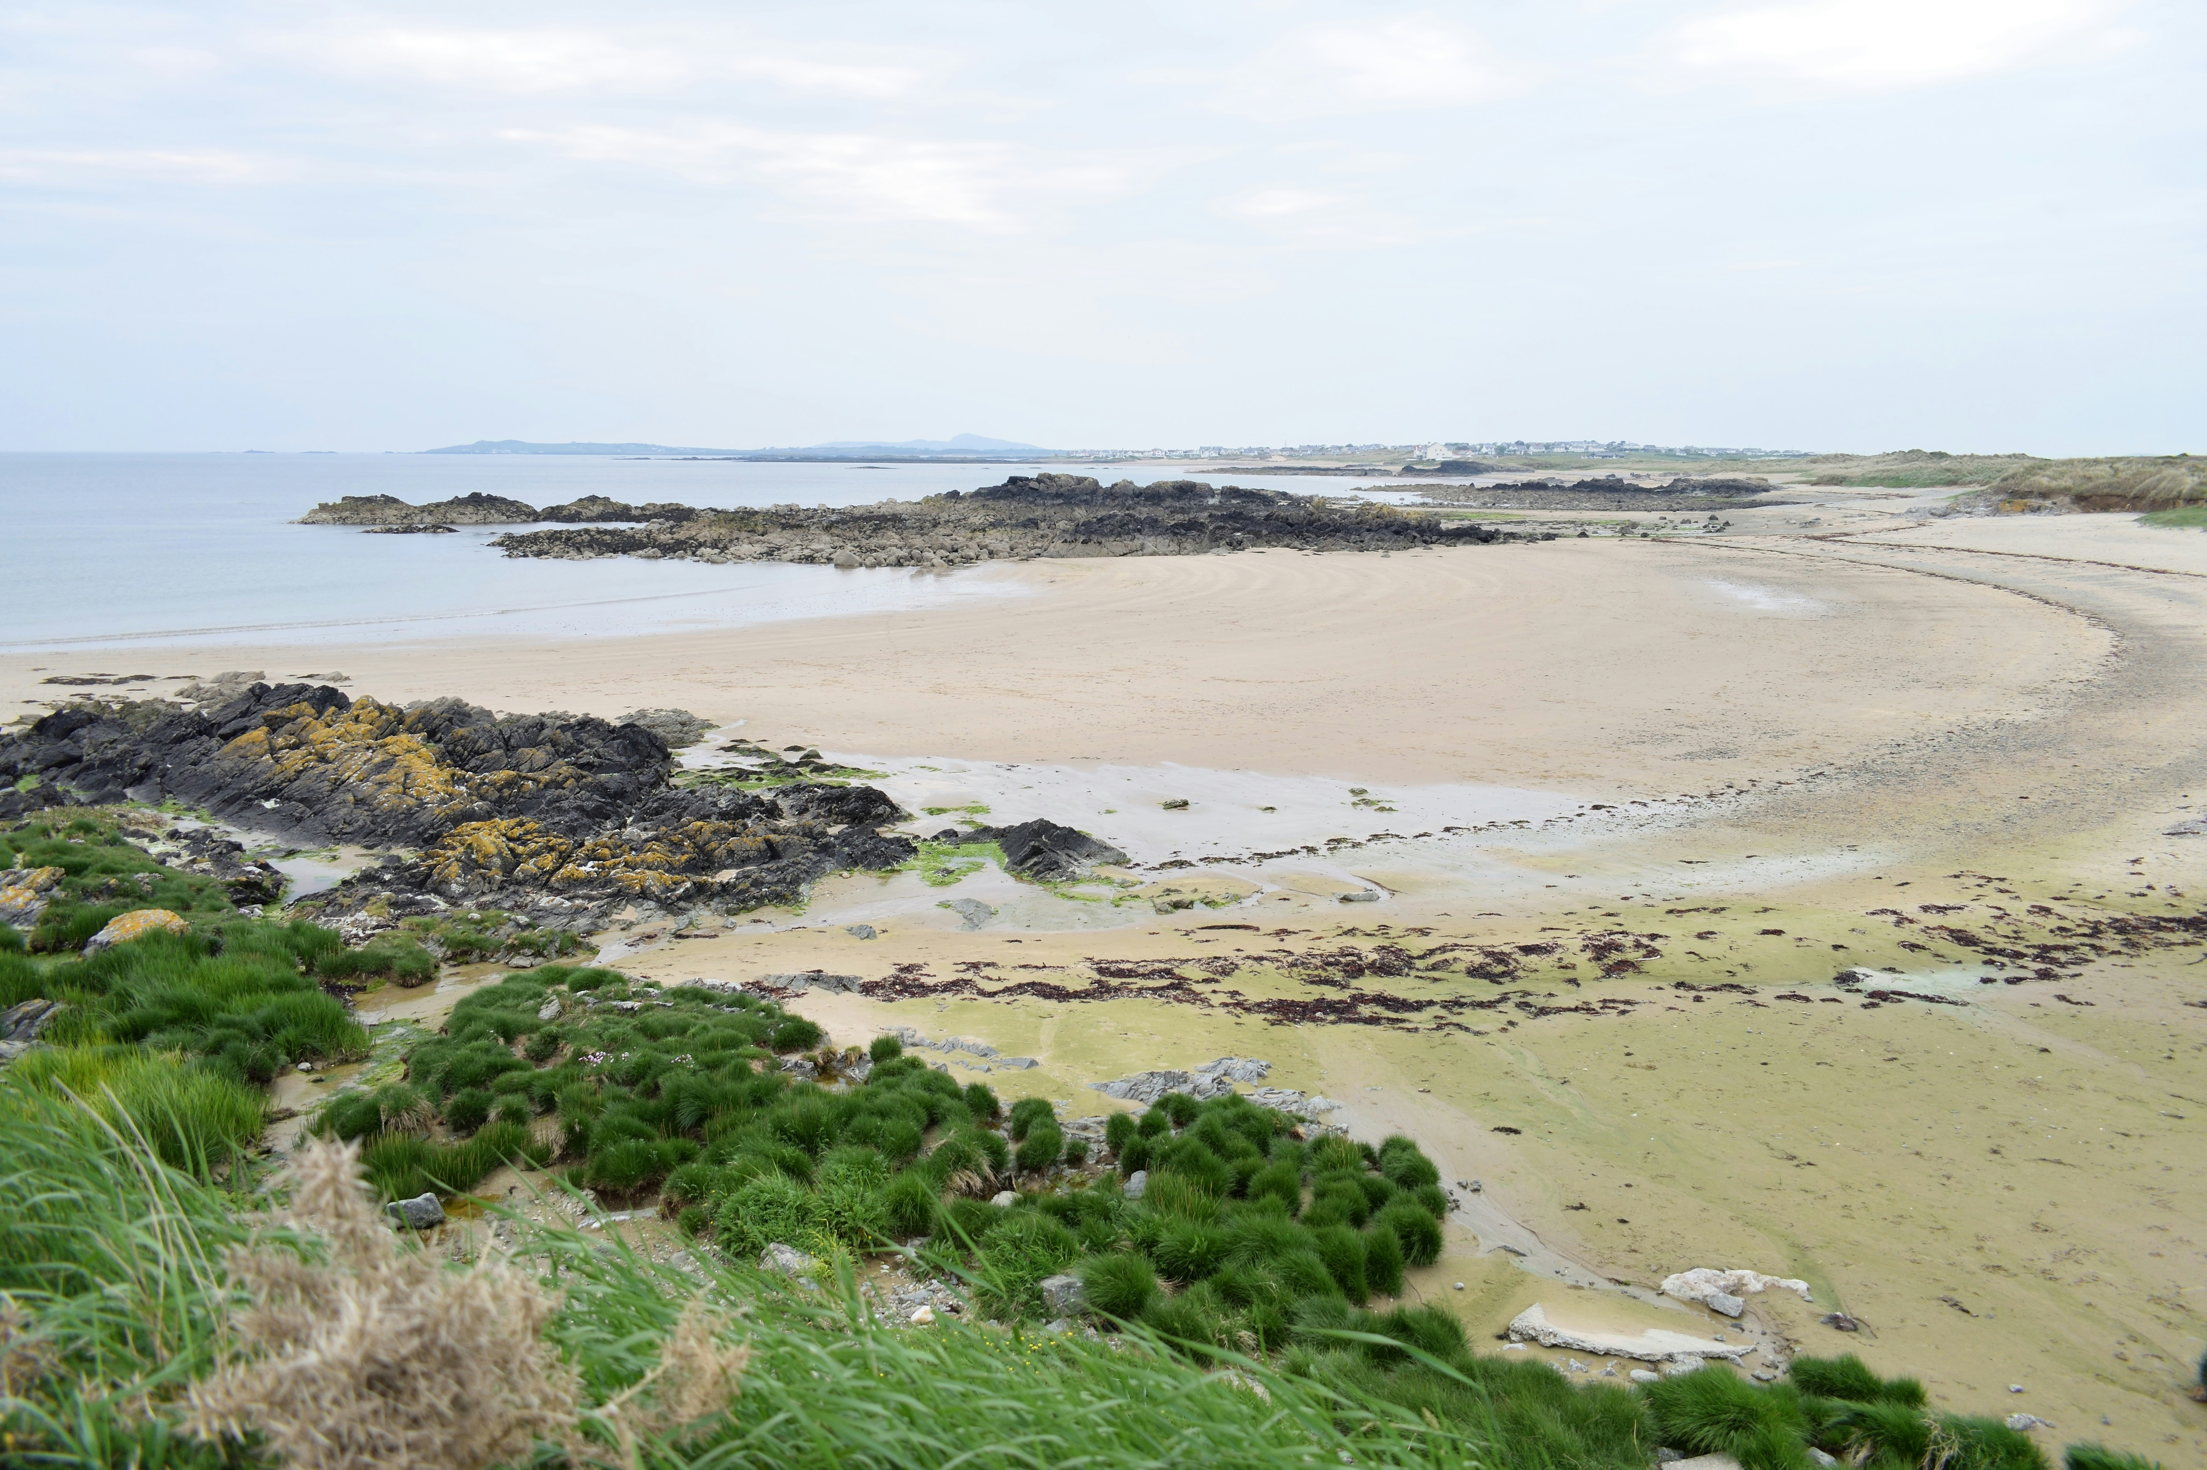
Learning Objectives
Discuss why water might be dangerous
Consider how I can keep myself and other people safe when in or near the water.

Slide 3



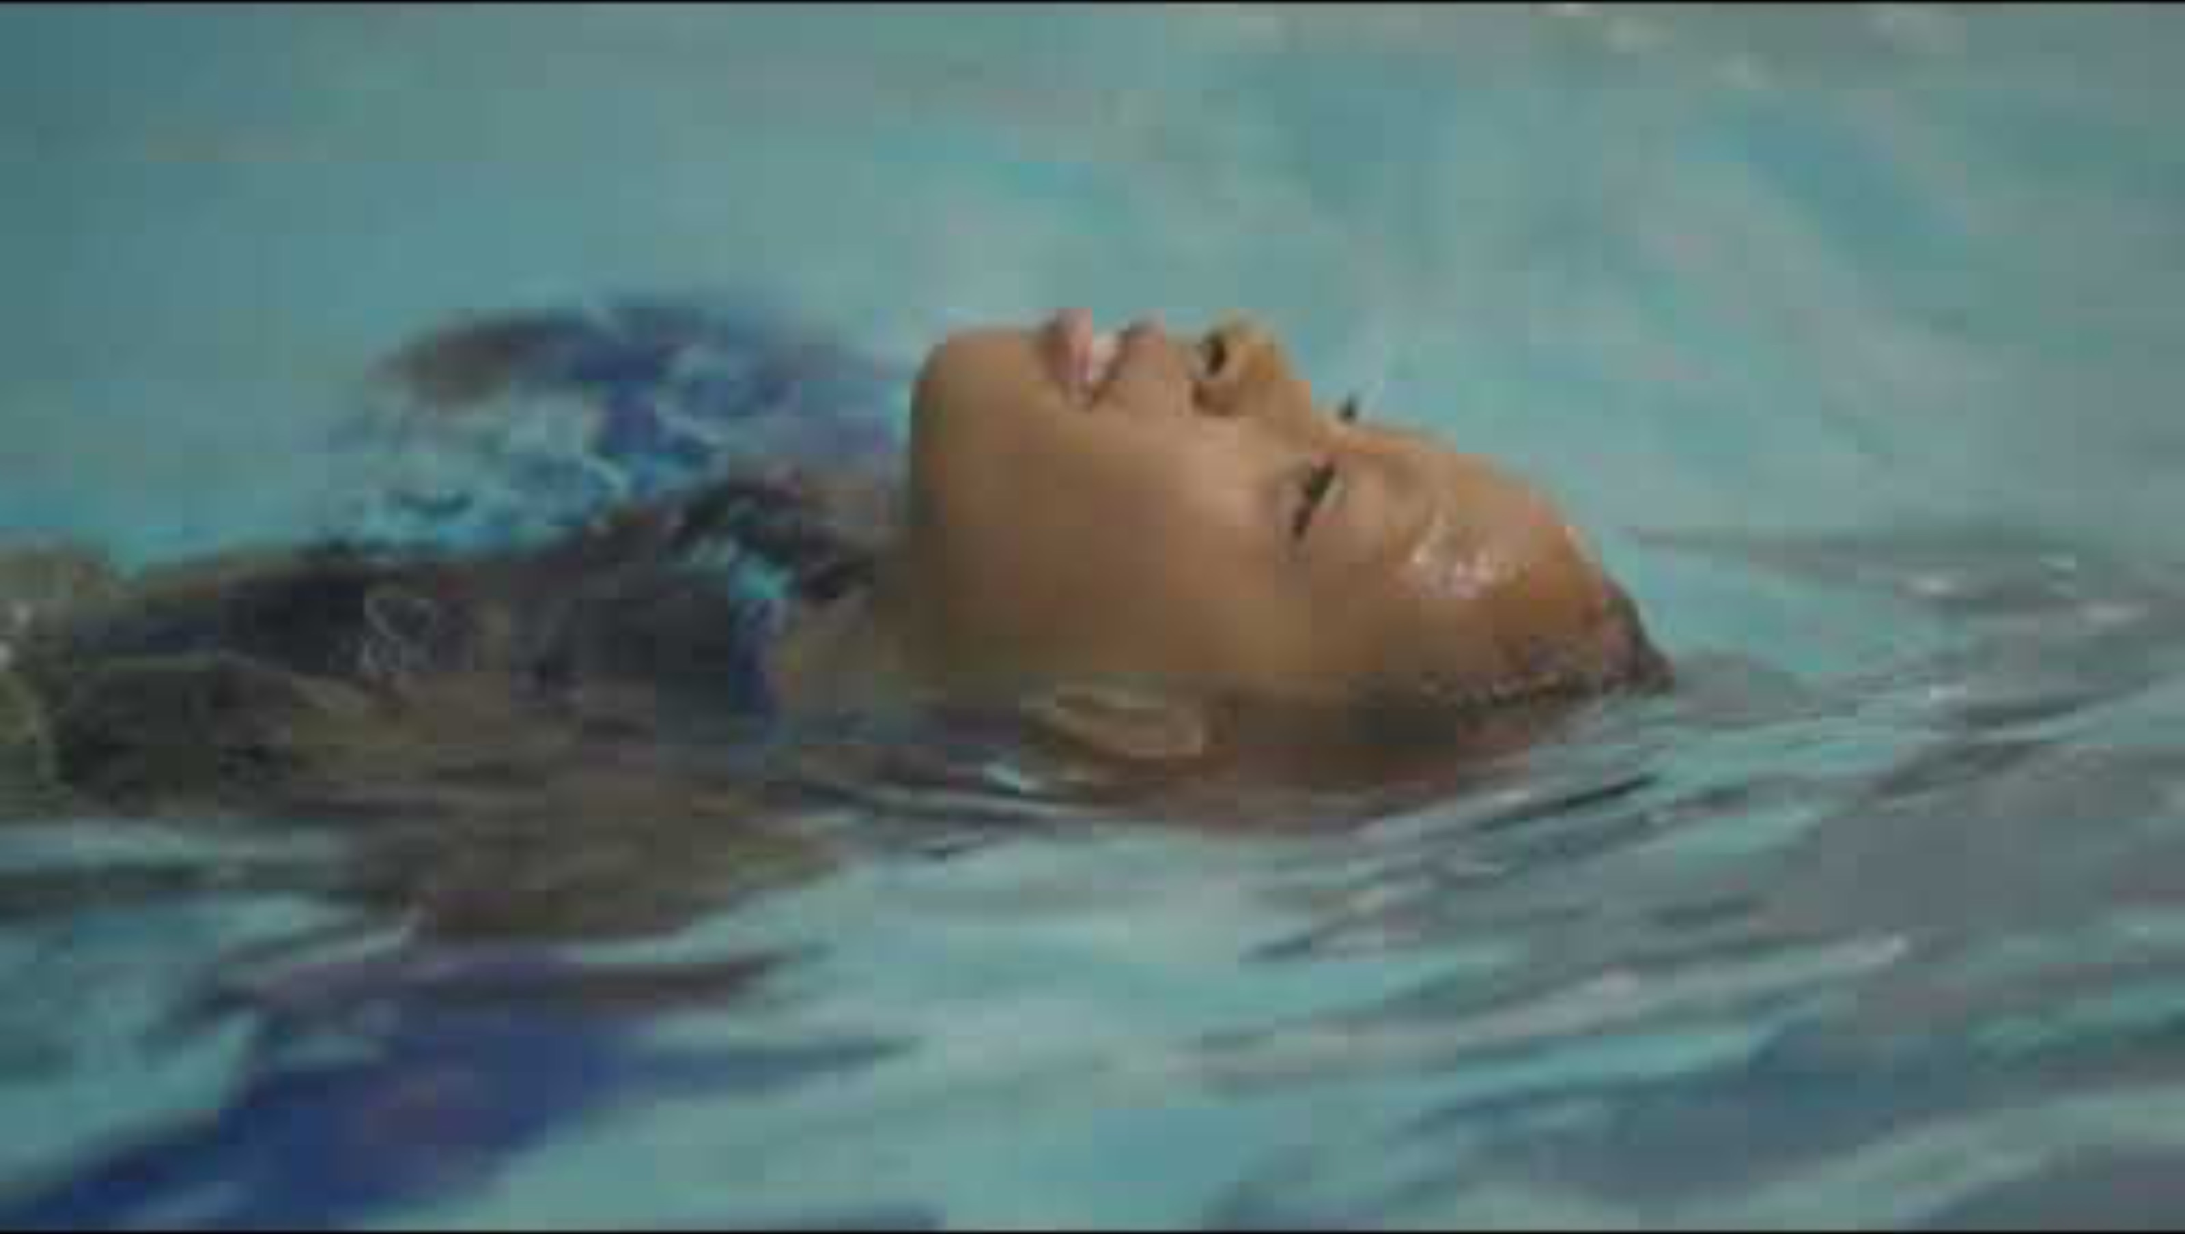

Remember to Float During the lesson, when you see the float icon ‘float’ by.
Stop and Think
Stay Together
Float
Call 999 in an Emergency

Slide 4
Word Bank and Water Safety Code
Stop and Think
Stay Together
Float
Call 999 in an Emergency
Cold water
Dangers
Depth of water
Weather
Hidden hazards
Make sure an adult is with you at all times
Keep within your depth
Be prepared for a trip
Emergency
Floating
Relax/Be calm
Treading water (to be discussed if appropriate for this level)
999
Coastguard
Police
Fire Service
Shout for help
Get an adult

Slide 5
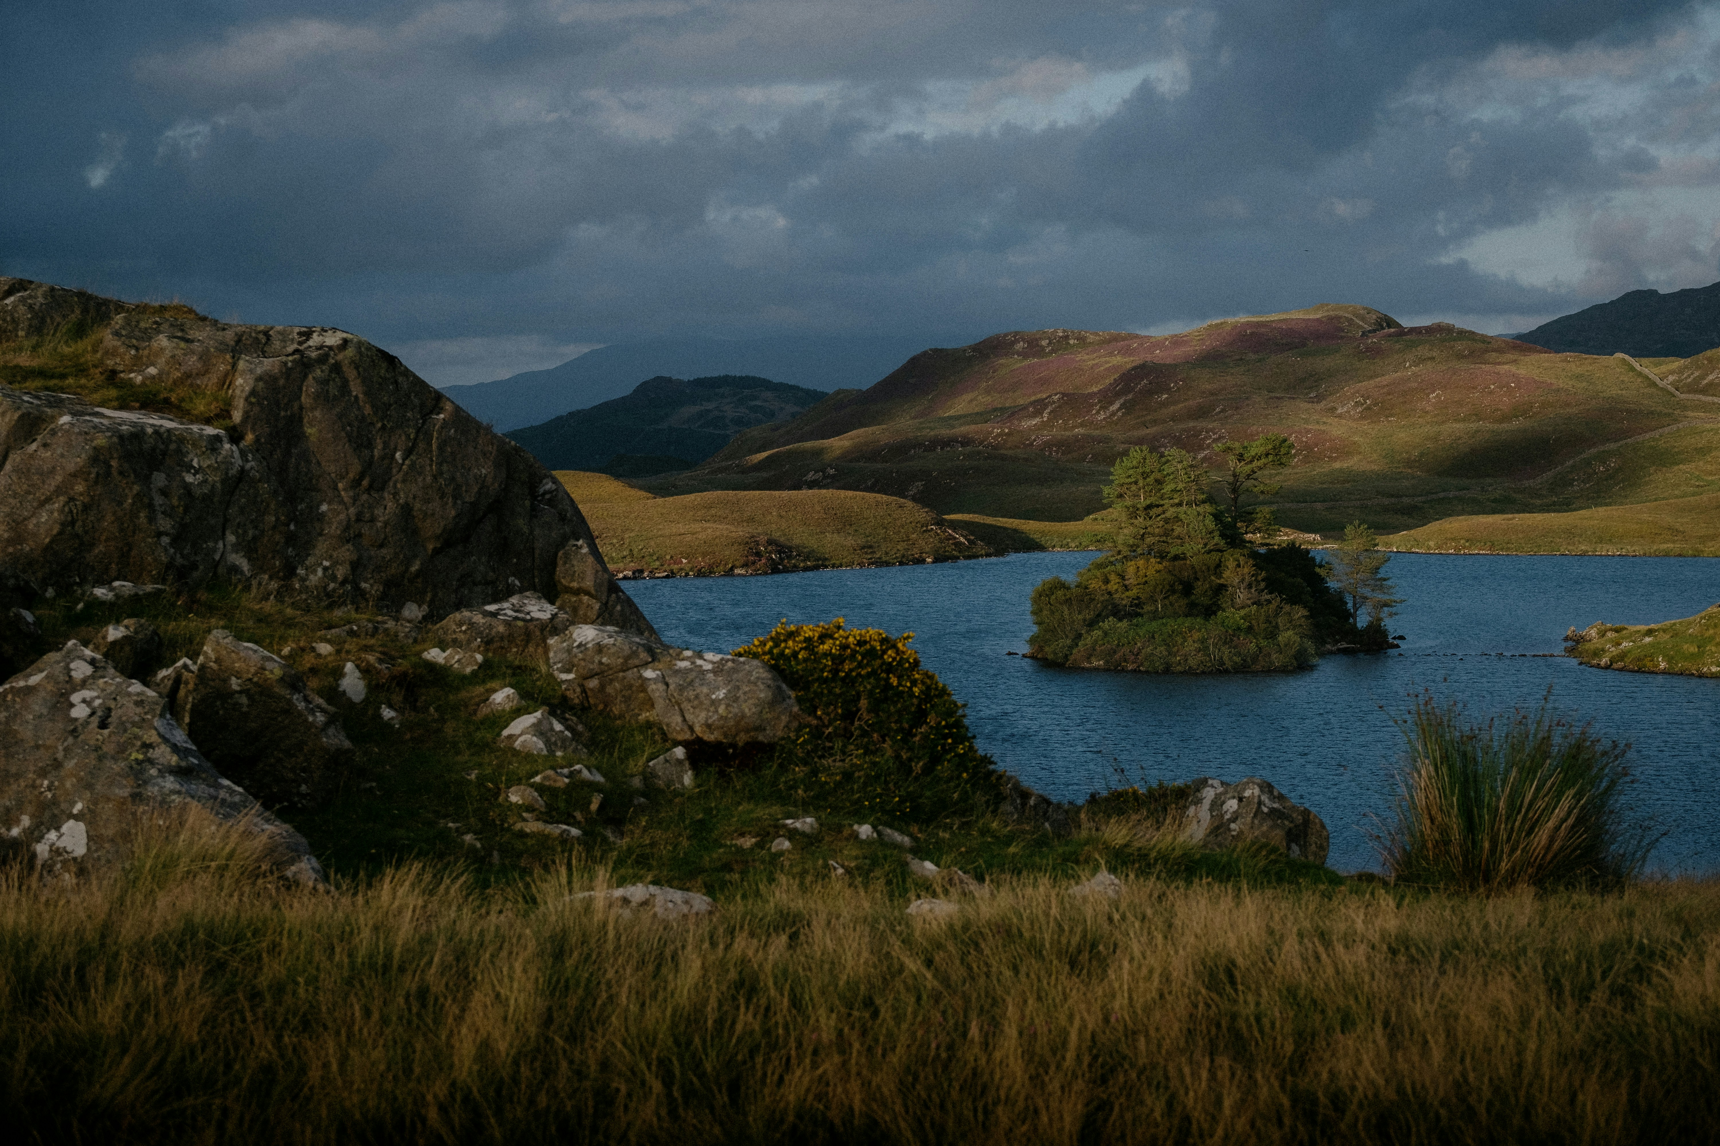
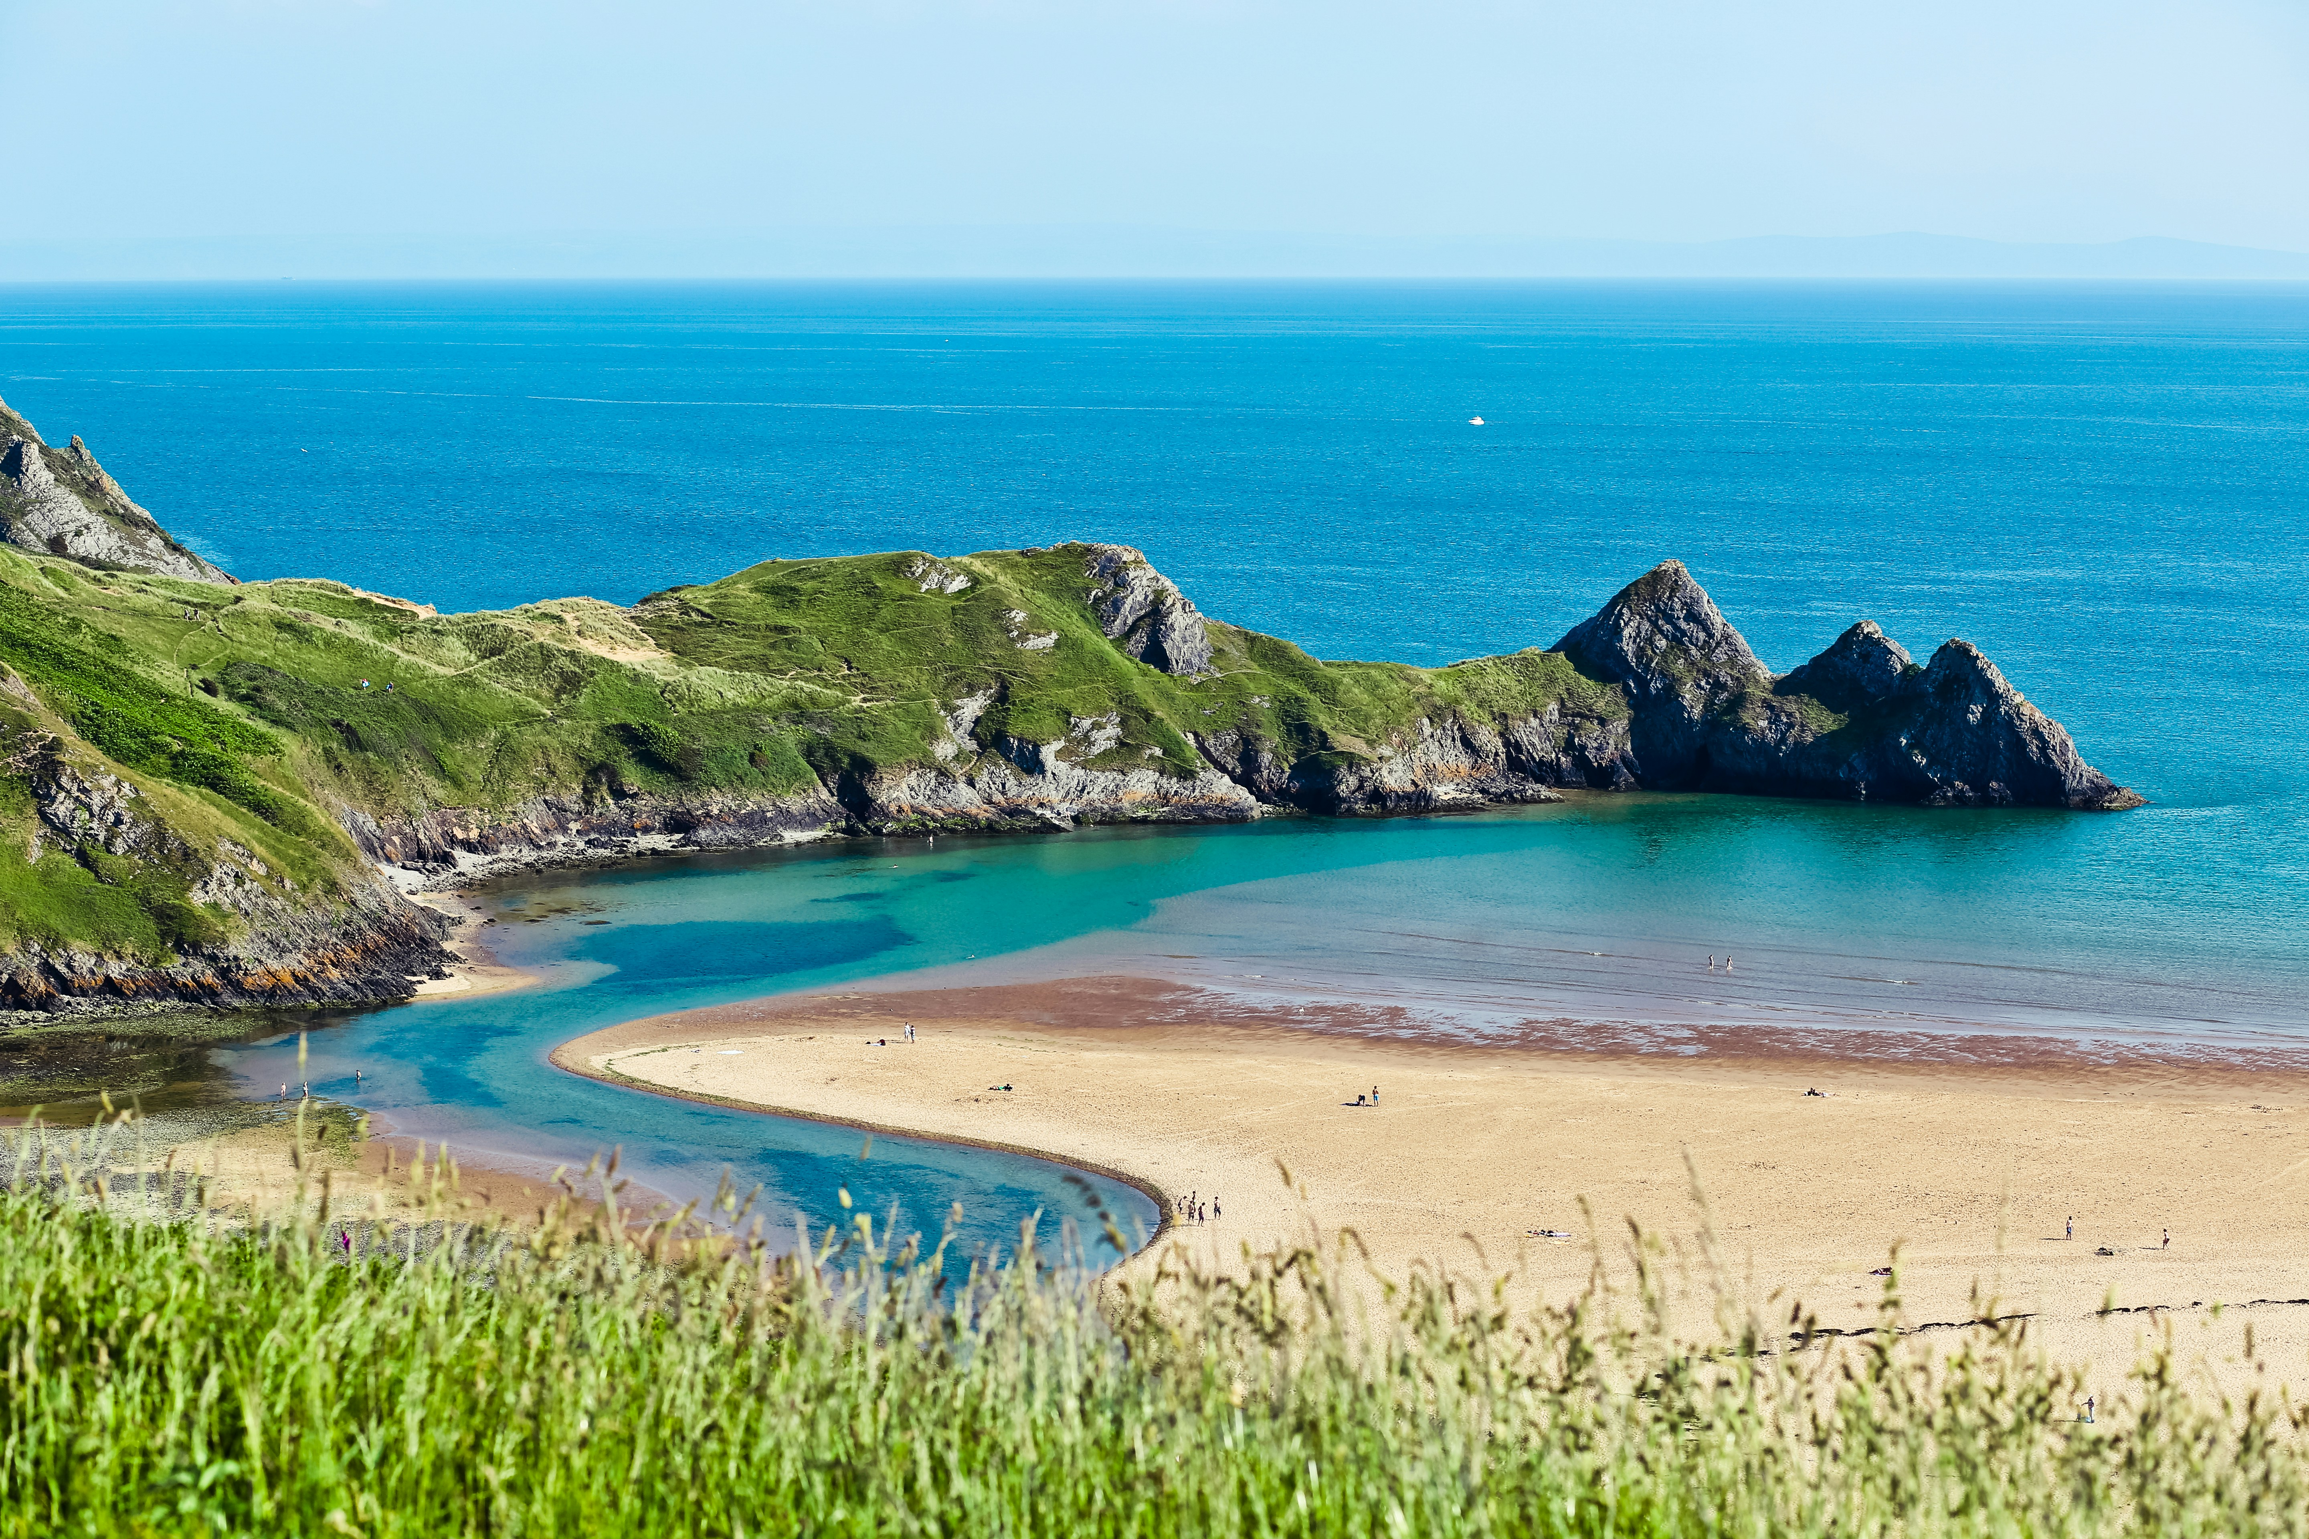
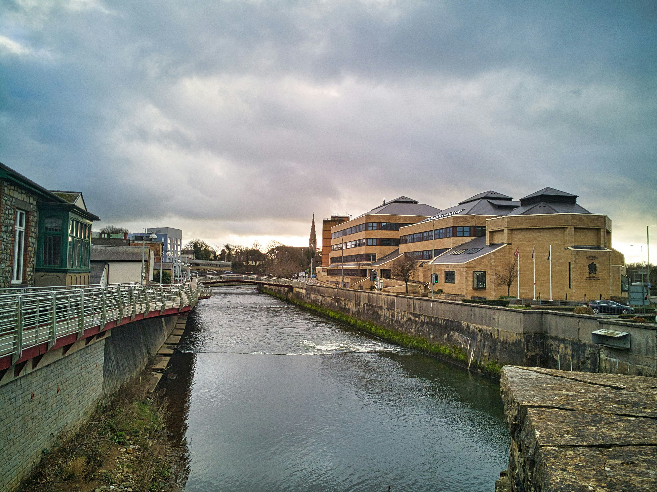
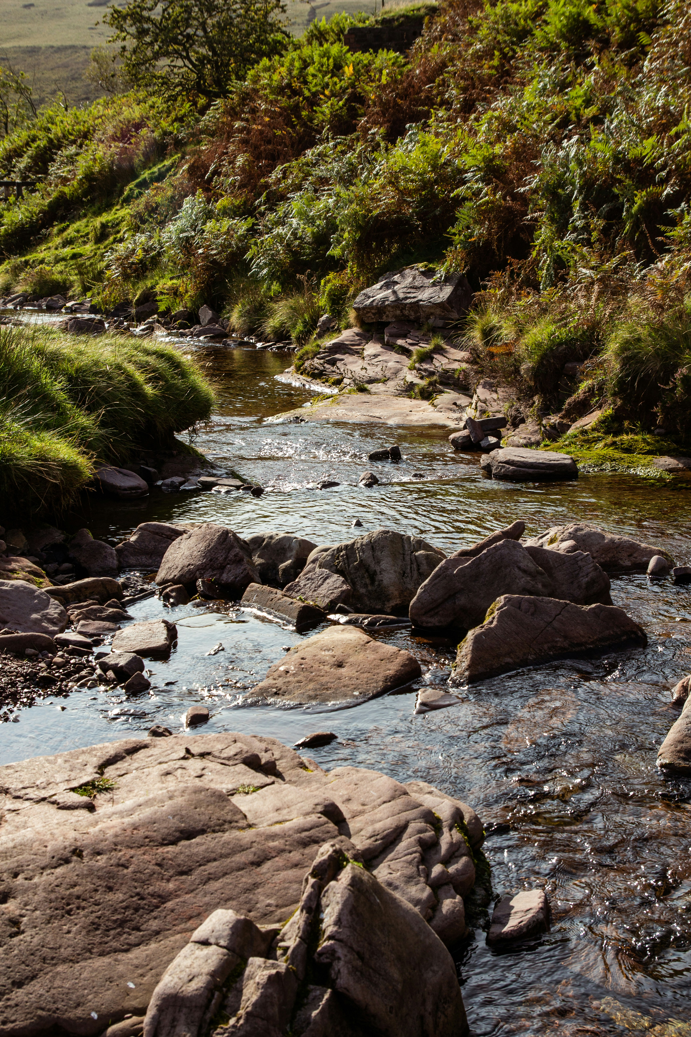

Why is it important to be careful around the Water?
Activity 1 (Starter)
What do you enjoy about water?

Slide 6
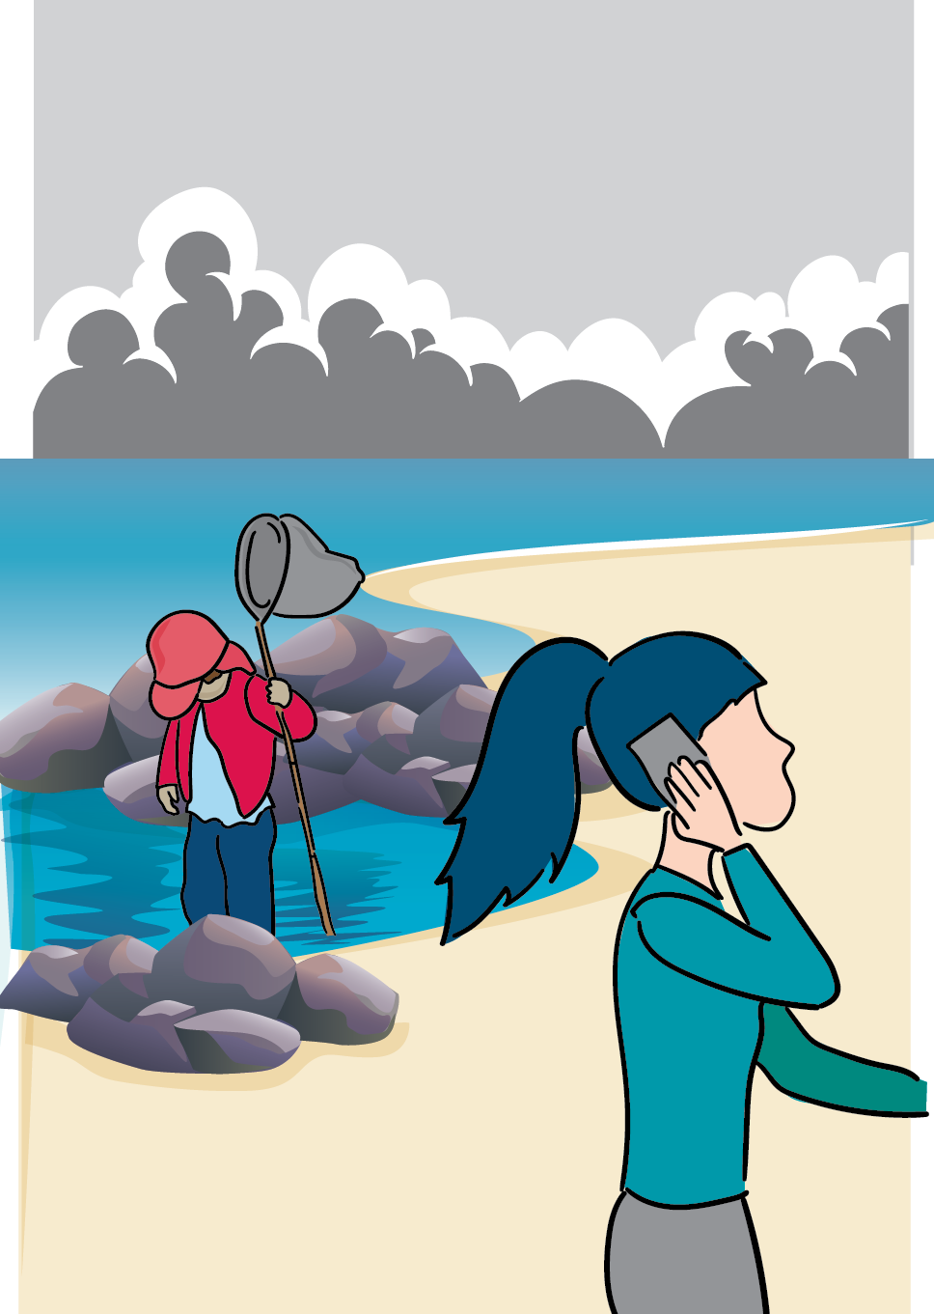
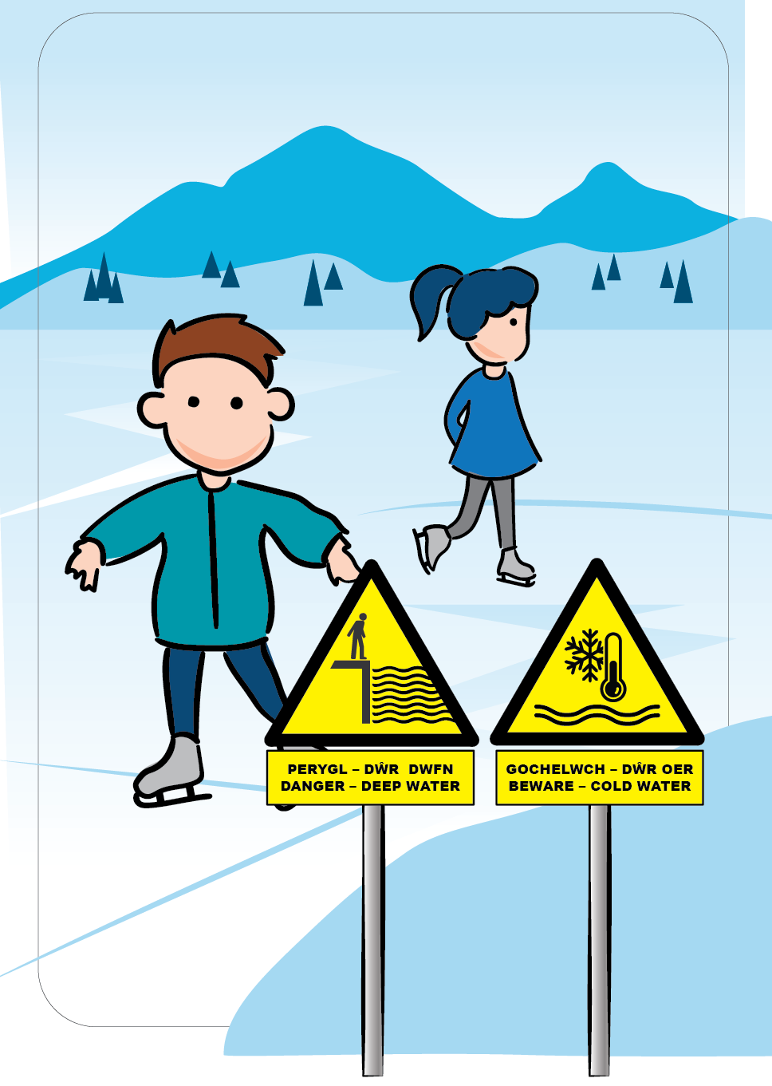
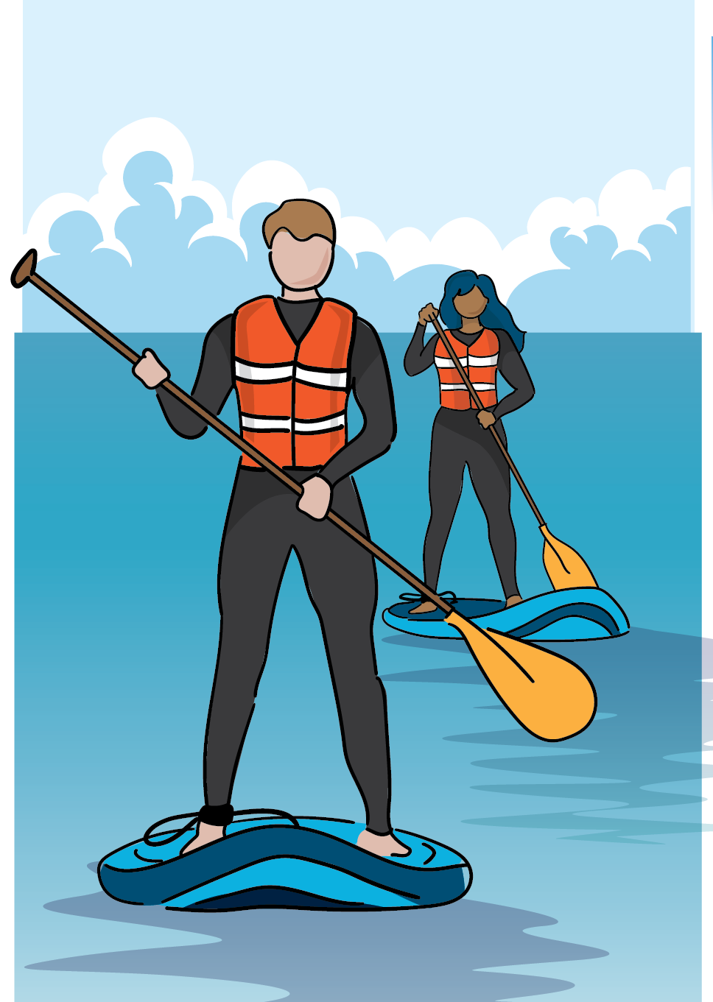
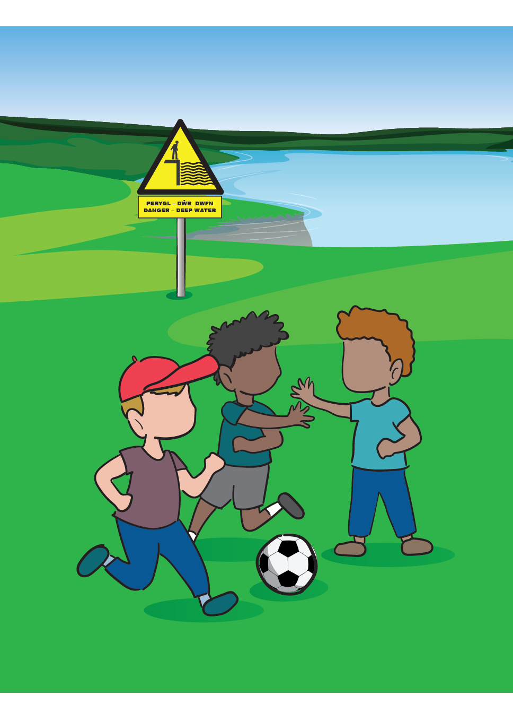
Stop and Think, Stay Together
Activity 2 – Stop and Think – Stay Together

Slide 7
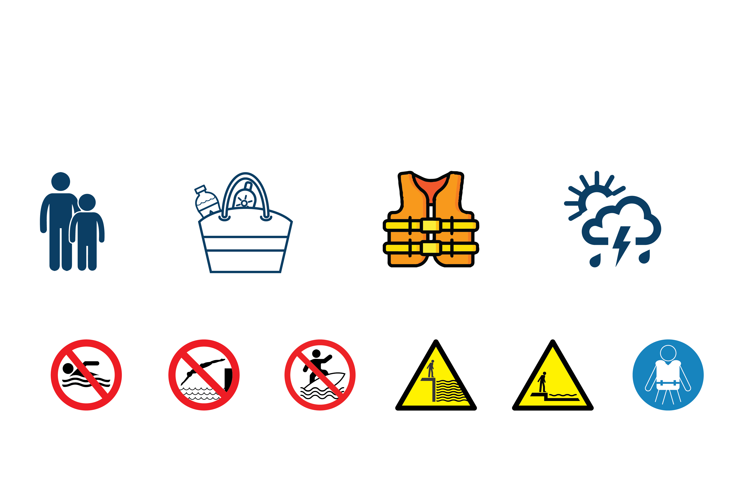

How can we stay safe and be prepared?
Activity 3 Stop and Think, Stay Together
Have you seen these signs before? What do they mean?

Slide 8
What have we learned so far?
Stop and Think
Stay Together

Slide 9
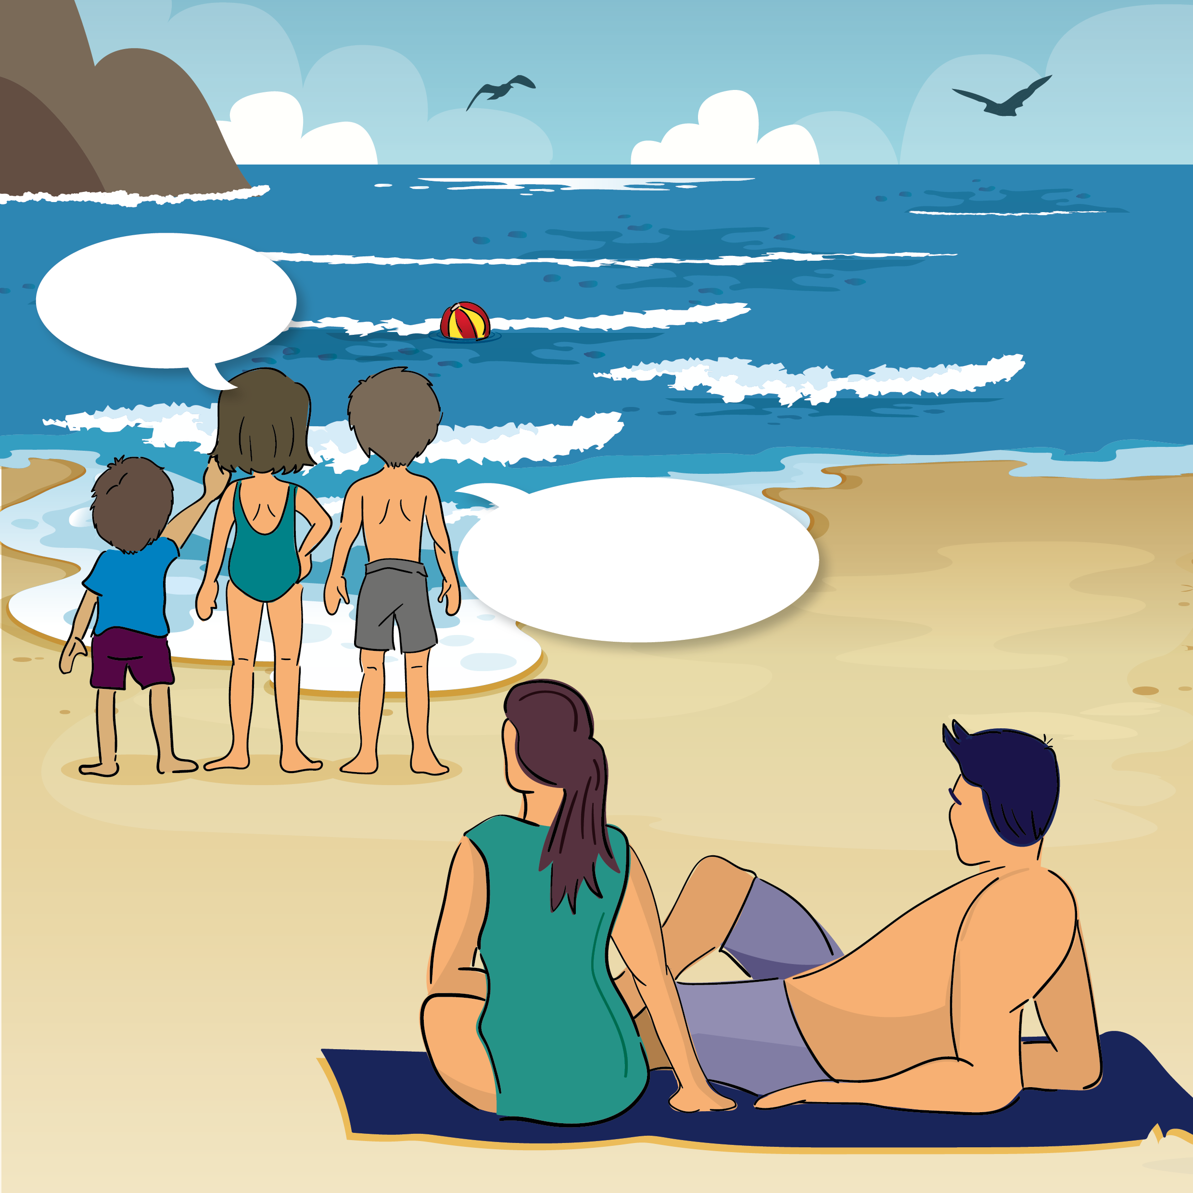
Activity 4
We should go in to get it.
We should not go in. It could be dangerous.

Slide 10
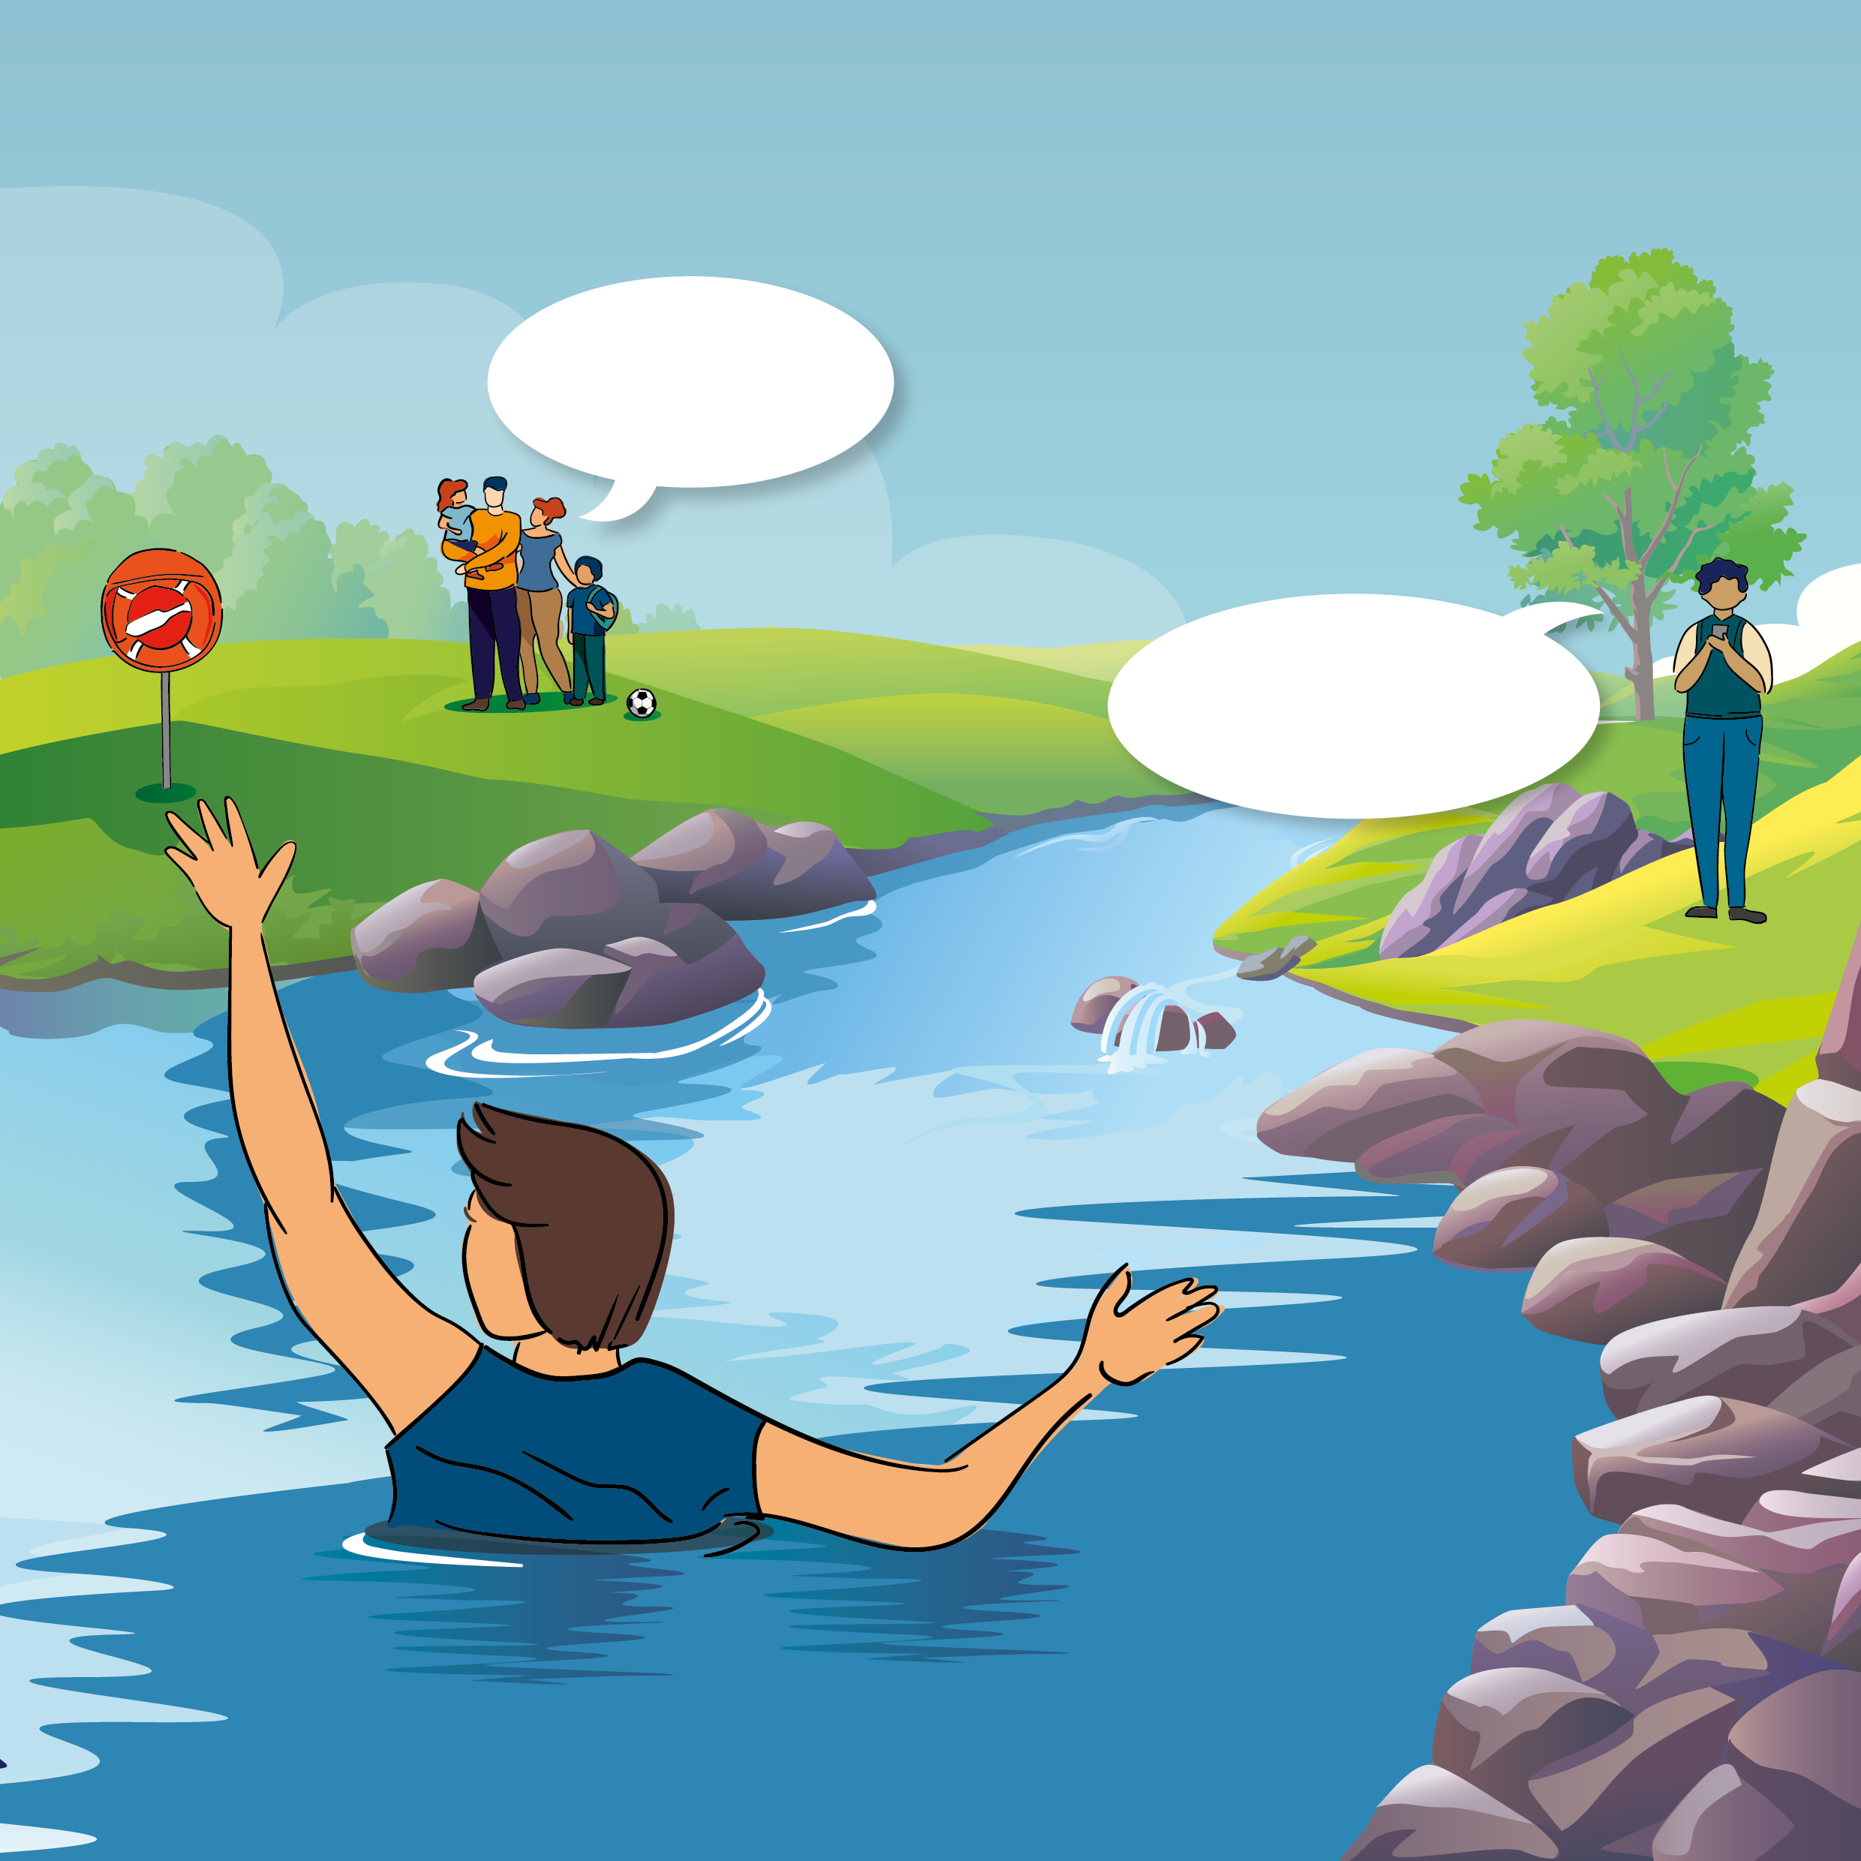
Activity 4
We should go in to help them.
We should ring 999 and ask for help.

Slide 11
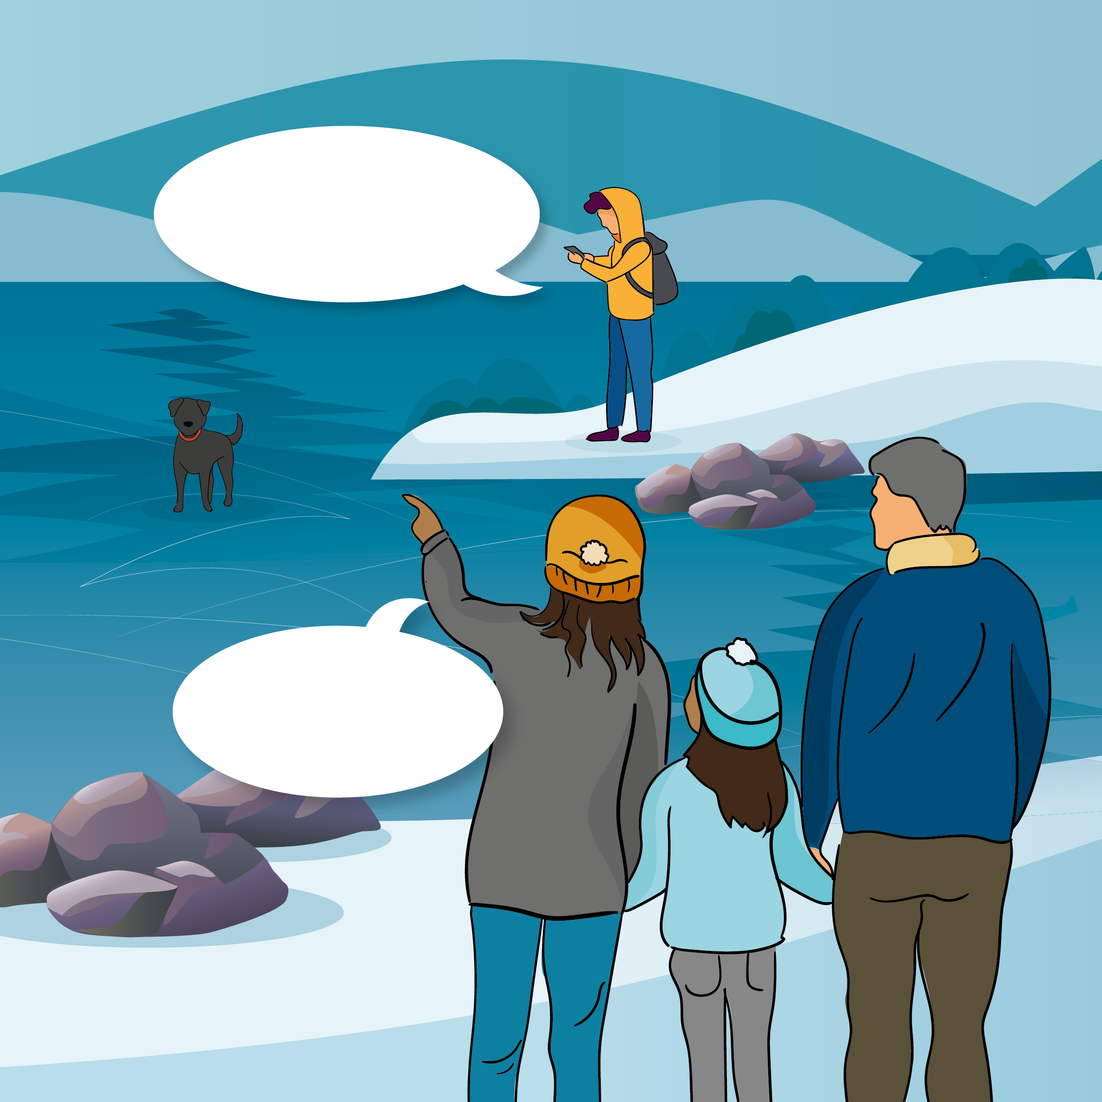
Activity 4
The ice might break. We should call 999 and ask for help.
We can go and help the dog. The lake is frozen.

Slide 12


Activity 4 Call 999 – In an Emergency
What to do in an Emergency
What not to do in an Emergency
Call 999 and ask for help
Keep an eye on the person in the water
Find something to help them
Float on your back and try to stay calm
Call for help or swim to safety
Never enter the water to help
Do not wait to call 999 or ask for help

Slide 13
Activity 5 Mini Quiz
Thumbs up or down:
Water can be fun but dangerous.
Not all dangers are easy to see.
The water is colder and stronger than you think.
I am safe on my own at the beach.
Being prepared with the right equipment and clothing will help keep me safe.
If I’m struggling in the water I should float on my back.
I should go into the water to help someone.
I should call 999 or get an adult if I see someone who needs help.
Stop and Think
Stay Together
Float
Call 999 in an Emergency

Slide 14
Summary of the Water Safety Code
Stop and Think
Stay Together
Float
Call 999 in an Emergency

